Slide 1
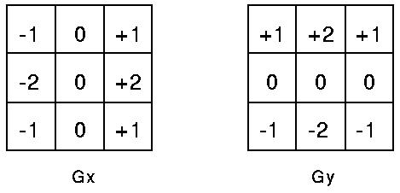

Sobel edge detector: Review
First these two masks are applied to the image.
The magnitude of the gradient is then calculated
using the formula which we have seen before:
Then, the two output tables of the masks and image are combined using the magnitude formula. This gives us a smoothened gradient magnitude output.

Slide 2
Algorithms for edge detection: Review
Algorithm 1:
Compute gradients
Compute magnitude
Threshold magnitude
Smoothing, followed by Algorithm 1
ie, the Sobel edge detector
The association property of convolutions

Slide 3
Sobel vs. Canny edge detectors: Review
 | Sobel | Canny
Smoothing | All ones / #ones | A Gaussian table/filter
Gradients | Horizontal & vertical gradients | Horizontal & vertical gradients
Magnitudes of gradients
Directions of gradients | n/a | tan(dir) = Gy / Gx
Flags | n/a | Non-maximum Suppression
Thresholding | One threshold | Double thresholding

Slide 4
Canny Part Three
Normally called Hysteresis Thresholding
We call it Double Thresholding

Slide 5
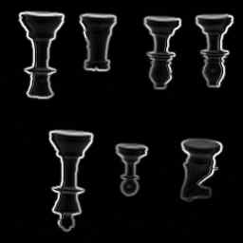
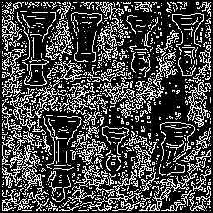
Double Thresholds
Let us first review what we have produced so far:
A Magnitude Image A Peaks Image

Slide 6
Double Thresholds
Two thresholds will be used
Will be applied to Magnitude image, but only to places that have shown up as peaks
Two thresholds, a HIGH and a LOW
If Mag exceeds HI, definitely pass pixel to Final
If Mag lower than LO, definitely never be in final
If Mag is between HI and LO, then check if
geographically adjacent to a position (pixel) that has made it in to Final; if yes, then pass pixel to Final

Slide 7
Double Thresholds
The typical way to write this is using Recursion.
Simply scan the image, looking only at Peaks, and at each Peak, ask if Mag exceeds HI; if No, do nothing (go on to next peak); if Yes, then call a recursive procedure on each of the 8 neighbors
The recursive procedure must use LO to determine if it should call itself again on the 8 neighbors of the peak it was given. If exceeds LO, call recursion.

Slide 8
Double Thresholds
Since we do NOT assume that all students in class know how to write recursion, here is an iterative, simple-to-follow, but inefficient procedure:
For i, For j
if peaks(ij) == ON
if mag(ij)> HI
peaks(ij) = OFF, flags(ij) = ON
else if mag(ij)< LO
peaks(ij)=flags(ij)= OFF.
Then, do the WHILE-LOOP from next slide.

Slide 9
Simple, inefficient cont’d
moretodo=ON
While moretodo==ON
moretodo= OFF
For i, For j
if peaks(ij) == ON
For p (-1 to +1), For q (-1 to +1)
if flags(i+p,j+q) == ON
peaks(ij) = OFF, flags(ij) = ON, moretodo=ON
ALL DONE

Slide 10
Simple, inefficient : All on One slide
For i, For j
if peaks(ij) == ON
if mag(ij)> HI
peaks(ij) = OFF, final(ij) = ON
else if mag(ij)< LO
peaks(ij)=flags(ij)= OFF.
moretodo=ON
While moretodo==ON
moretodo= OFF
For i, For j
if peaks(ij) == ON
For p (-1 to +1), For q (-1 to +1)
if flags(i+p,j+q) == ON
peaks(ij) = OFF, flags(ij) = ON, moretodo=ON
ALL DONE

Slide 11
Simple, inefficient cont’d
inefficient Case: LLLLLLLL
L
L MMMMMMMMMMMMMMM
L M
L HHHH M
L M M M
L M M M
L MMMMMMMM M
M M
M M
MMMMMMMMMMMMMMMMMM
Thankfully, most M-chains are small.

Slide 12
Canny Part Four
Automatically get HI (and hence LO)

Slide 13
Automatically Get HI
Use Percent as input
Then apply it to histogram of scaled mags
In the histogram of scaled mags, find the
Point that exceeds Percent of all, mark that
as HI. Then, LO is 0.35 of HI

Slide 14
Details of Automatically Get HI
Read Percent as input
Compute Histogram of scaled magnitudes
CutOff = Percent*Rows*Cols
for (i= HistogramSize downto 1, i--)
AreaOfTops += Histogram[i]
if (AreaOfTops>CutOff)
Break out of for-loop
HI=I
LO= .35*HI
Histogram of scaled magnitudes obtained by:
for i, for j
(Histogram[Magnitude[I,j]])++

Slide 15
Details of Automatically Get HI
In the histogram of scaled mags, find the
Point that exceeds Percent of all, mark that
as HI.
x
xxx x xx
xxxxx xx xx x xx xxx
xxxxxx xxx xx xx xxx xxxx x xxxxx
xxxxxxx xxxx xxx xx xxxx xxxxxx xxx xxxxxx x
xxxxxxxx xxxxx xxxx xxxx xxxxxxxxxxxxxxxx x xxxxxxx xxx
xxxxxxxxxxxxxxx xxxxx xxxx xxxxxxxxxxxxxxxxxx xxx xxxxxxxxx xxxx
xxxxxxxxxxxxxxxxxxxxxxxxxxxxxxxxxxxxxxxxxxxxxxxx xxxxxxxxxxxxxxxxxxxx
-------------------------------------…-----------------

Slide 16
Complete Canny Algorithm
Part One: Compute Gradient Magnitude
Part Two: Compute Peaks
Part Four: Automatically Computer HI and LO
Part Three: Double Threshold

Slide 17
 | Sobel | Canny
Smoothing | All ones / #ones | A Gaussian table/filter
Gradients | Horizontal & vertical gradients | Horizontal & vertical gradients
Magnitudes of gradients
Directions of gradients | n/a | tan(dir) = Gy / Gx
Flags | n/a | Non-maximum Suppression
Thresholding | One threshold | Double thresholding
Automatically choose thresholds | Applicable | Applicable

Slide 18
About the example code marrh.c
-- Marrh.c uses flexible size masks (which we need), we will keep
this part of the code.
-- Marrh.c uses second derivatives, whereas we need only first derivatives
(we need first x- and y- derivatives), so we will change the equation
in the marrh.c line to be the first x-derivative. Read and delete this part
-- Then, because we need two derivatives, we will double up on that line,
i.e., make a copy of it to compute the y-derivative, finally ending
up with two masks (xmask and ymask). See sobel.c for reference.

Slide 19
Canny Algorithm, Part One
-- Then use the convolution code from marrh but remember to double up on it, to get two outputs. A good example showing how to do convolution.
-- Then delete the code in marrh that is below the convolution code.
-- Then bring in the sqrt (of squares) code from sobel. This will compute the
magnitude, will scale it for output, and will print it out.
-- At this point, you are done with Canny part One, and your code should
produce output very similar to the Sobel magnitude image.

Slide 20
Notetaker Needed for CAP 4453.0001 - Earn up to 40 hours of community service

